Slide 1
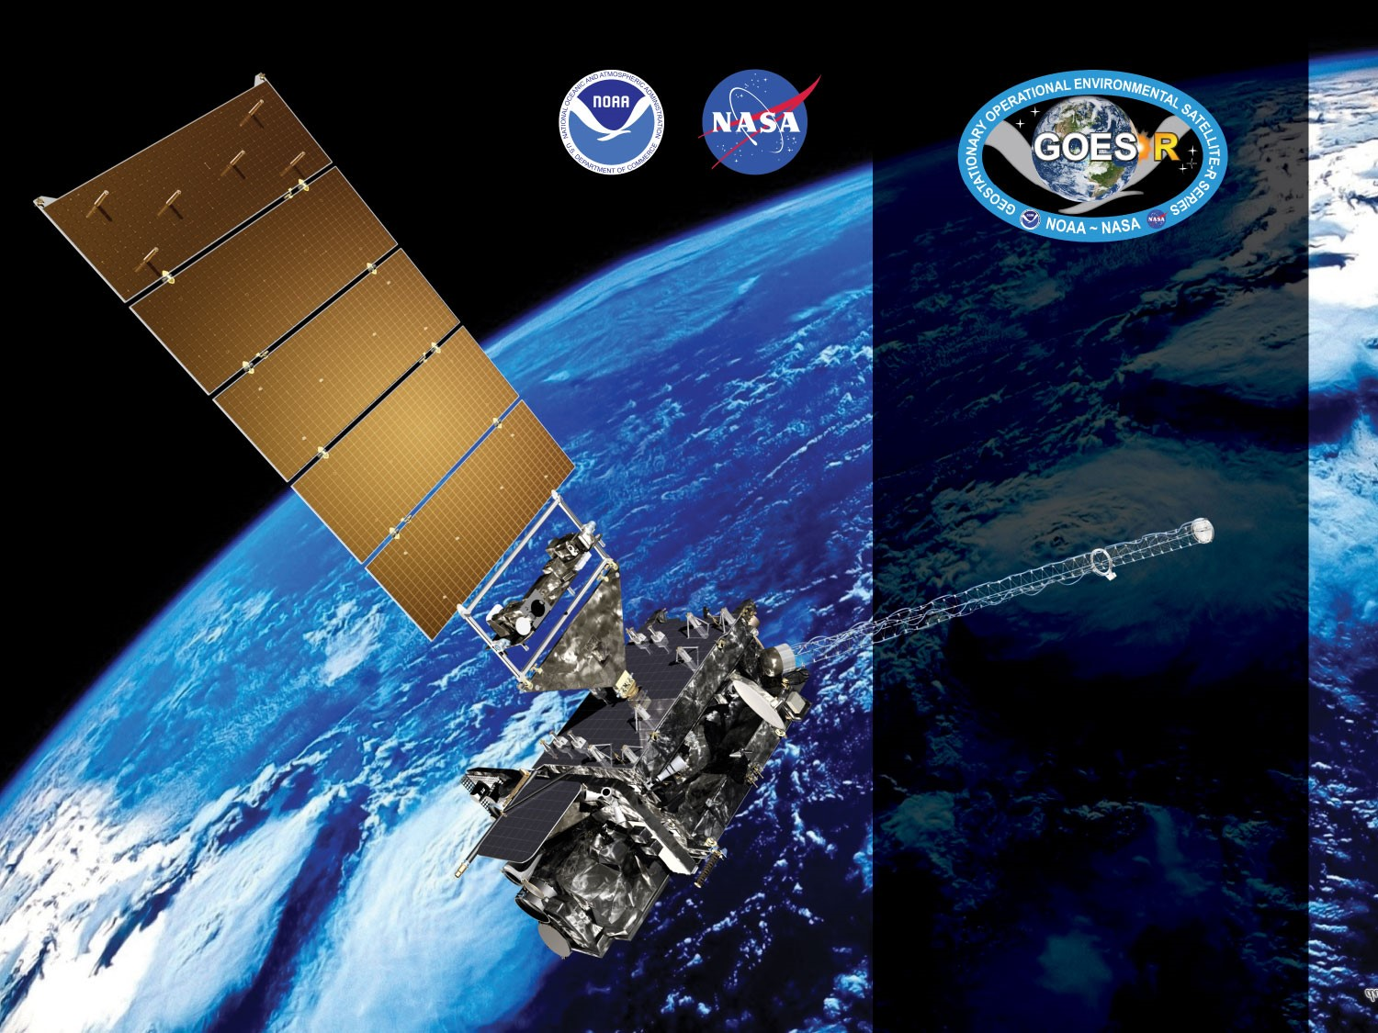
GOES-17 ABI L2+ Rainfall Rate / QPE Provisional PS-PVR
May 16, 2019
GOES-R AWG
Bob Kuligowski*, Yaping Li⁺,
NOAA/NESDIS/STAR*
IMSG Inc. ⁺

Slide 2
Outline
Product Overview
Product Quality Evaluation
General approach
Limb Effects
Provisional Maturity Assessment
Path to Full Validation Maturity
Issues and status
Risks
Summary and Recommendations

Slide 3
PRODUCT OVERVIEW
GOES-17 Rainfall Rate / QPE L2 Product Provisional PS-PVR

Slide 4
Product Overview
The GOES-R ABI Rainfall Rate / QPE uses single-image data from five different spectral bands to retrieve estimates of instantaneous rainfall rate at the full IR pixel scale for the entire full disk. These five bands are transformed into 16 predictors, 8 of which are nonlinear transformations of the first 8:
T_{6.2} - 174 K | T_{8.5} - T_{7.34} + 30 K
S = 0.568*(T_{min,11.2}-217 K) + 25 K | T_{11.2} - T_{7.34} + 20 K
T_{avg,11.2} - T_{min,11.2} – (S – 25 K) + 85 K | T_{8.5} - T_{11.2} + 30 K
T_{7.34} - T_{6.19} + 30 K | T_{11.2} - T_{12.3} + 20 K
Separate pairs of predictors from this set are used for rain / no rain discrimination (linear only) and rain rate retrieval (both).
NOTE: This product has no precedents; i.e., it uses only L1b radiances as input.

Slide 5
Product Overview
Separate rain / no rain and rain rate retrieval equations were calibrated against microwave rain rates (CPC MWCOMB). The algorithm was designed to allow real-time updating of the calibration coefficients, but the operational code has a fixed set.
Separate calibration equations were developed for each 30° latitude band and each of 3 different cloud types:
Type 1 (“water cloud”): T_{7.34} < T_{11.2} and T_{8.5}-T_{11.2} < -0.3 K
Type 2 (“ice cloud”): T_{7.34} < T_{11.2} and T_{8.5}-T_{11.2} ≥ -0.3 K
Type 3 (“cold-top convective cloud”): T_{7.34}≥T_{11.2}
The resulting rain rates are then adjusted to match the distribution of the calibration MW rain rates using LUTs based on PDF matching of the initial output rain rates with MWCOMB.

Slide 6
Product Overview: Specifications
Rainfall Rate / QPE | Specification
Geographic Coverage | Full Disk
Measurement Range | 0-100 mm/h
Measurement Accuracy | 6 mm/h at a rate of 10 mm/h with higher values at higher rates*
Refresh Rate | 15 min (Modes 3/4); 10 min (Mode 6)
Measurement Precision | 9 mm/h at a rate of 10 mm/h with higher values at higher rates*
* Quantitative evaluation only for satellite zenith angles < 70° and latitudes equatorward of 60°

Slide 7
Review: Time-Line/Context
1 March 2018 GOES-S Launch
12 March 2018 GEO orbit attained (became GOES-17)
3 May 2018 AWG established access to GS L2 products; qualitative RRQPE L2 product validation begins.
27 August 2018: RRQPE L2 product is declared Beta validated
13 September 2018: 6-pixel N-S navigation shift between MW and LW IR bands fixed; quantitative product validation at checkout position begins.
24 October 2018: Drift from checkout position at 89.5°W begins; quantitative product validation at checkout position ends.
13 November 2018: Drift to operational position at 137°W ends; quantitative product validation at operational position begins.

Slide 8
Product quality evaluation
GOES-17 Rainfall Rate / QPE L2 Product Provisional PS-PVR

Slide 9
Provisional PLPT
PLPT ID | Descriptive Title | % Complete | Results | AWG POC
ABI-FD_QPE04 | Assess accuracy and precision of product | 100 | Complete | AWG
Because of heating of the ABI Focal Plane Module (FPM) due to degraded Loop Heat Pipe (LHP) performance, the analysis is restricted to time periods where the FPM temperature < 81 K.
For simplicity, all data between 0500 UTC and 2000 UTC were ignored in this analysis.

Slide 10
Top Level Evaluation
 | Current Status | Future Outlook
Quantitative Performance: (Accuracy, Precision) | Algorithm performance over the CONUS vs. gauge-adjusted MRMS is degraded relative to GOES-16 and does not meet spec. Performance over the full disk vs. GPM DPR is similar to GOES-16 but does not meet spec. The root cause is the longer limb over the CONUS of GOES-17 vs. GOES-16. The RRQPE algorithm uses B14-B10 to separate deep convection from other rainfall types, and since limb cooling is stronger for WV than for an IR window, B14-B10 on average becomes more negative as satellite zenith angle (SZA) increases. This was not observed for GOES-16 because the CONUS has significantly lower SZAs for GOES-16 than GOES-17. Furthermore, the MRMS data are more sparse over regions with high GOES-16 SZAs, but the opposite is true of GOES-17, meaning that the MRMS validation will be skewed toward high-SZA pixels. | Attempting to modify the calibration (which is the same for all longitudes) would improve performance over the CONUS but degrade performance over Hawaii, and most CONUS users probably use GOES-16 over GOES-17 anyway. Limb adjustment is possible for IR window bands but not for WV bands; developing one would require significant expense. Longitudinally varying calibration in the operational code would address the problem but would introduce transition artifacts without substantial code modifications. Varying the threshold BTD values in the classification scheme with SZA is an option that will be explored for the Enterprise code. The Enterprise version of the code uses overlapping 15x15° lat/lon boxes with 5° of separation, which partially accounts for limb effects and avoids transition artifacts by using a distance-weighted average of the 9 15x15° boxes that contribute to each pixel.

Slide 11
Results of ABI-FD_QPE04
GOES-17 | Spec | Vs. Q3 |  | Vs. DPR
 |  | 89.5°W | 137°W | 89.5°W | 137°W
Accuracy | 6.00 | 4.11 | 7.42 | 6.06 | 6.38
Precision | 9.00 | 7.92 | 9.99 | 9.37 | 9.51
At checkout position, spec is met vs. Q3 (CONUS) but not vs. DPR over the full disk
At the operational position, spec is not met vs. either data set

Slide 12
Results of ABI-FD_QPE04
GOES-17 | Spec | Vs. Q3 |  | Vs. DPR
 |  | 89.5°W | 137°W | 89.5°W | 137°W
Accuracy | 6.00 | 4.11 | 7.42 | 6.06 | 6.38
Precision | 9.00 | 7.92 | 9.99 | 9.37 | 9.51
At checkout position, spec is met vs. Q3 (CONUS) but not vs. DPR over the full disk
At the operational position, spec is not met vs. either data set
BUT at 137°W during NH cool season when GOES-16 performs worse; expect better performance in warm season
GOES-16 (last 12 mos) | Spec | Vs. Q3 |  | Vs. DPR
 |  | May-Oct | Nov-Apr | May-Oct | Nov-Apr
Accuracy | 6.00 | 4.89 | 6.53 | 6.19 | 6.67
Precision | 9.00 | 8.93 | 9.77 | 9.27 | 9.50

Slide 13
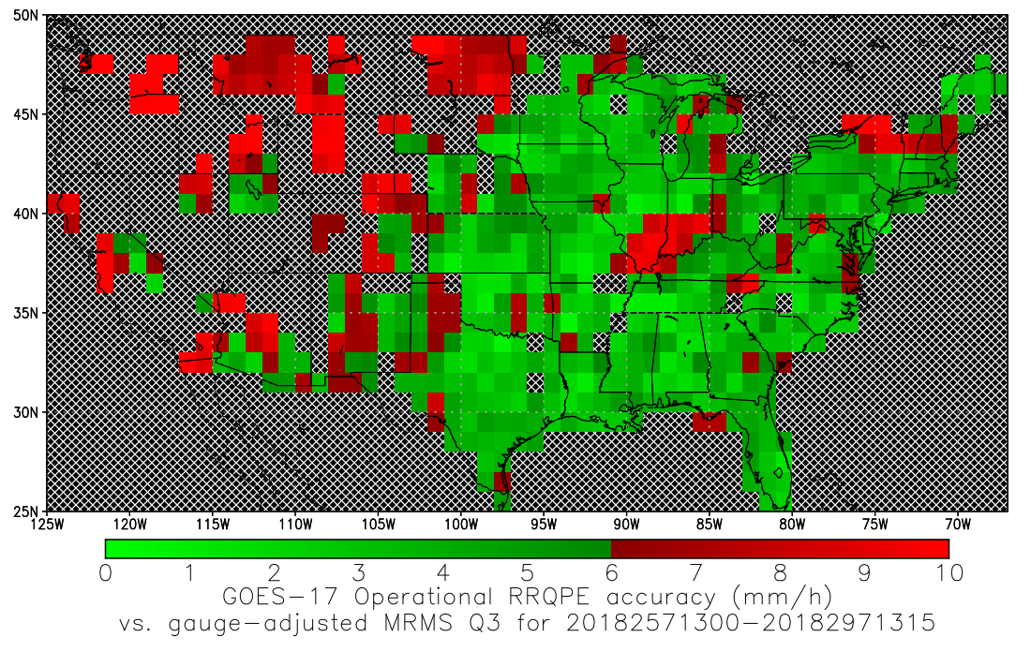
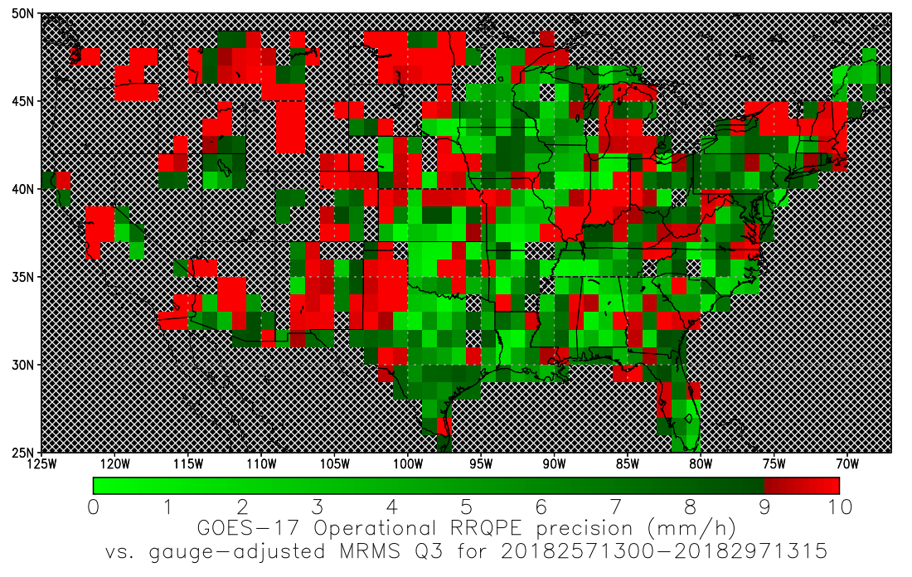
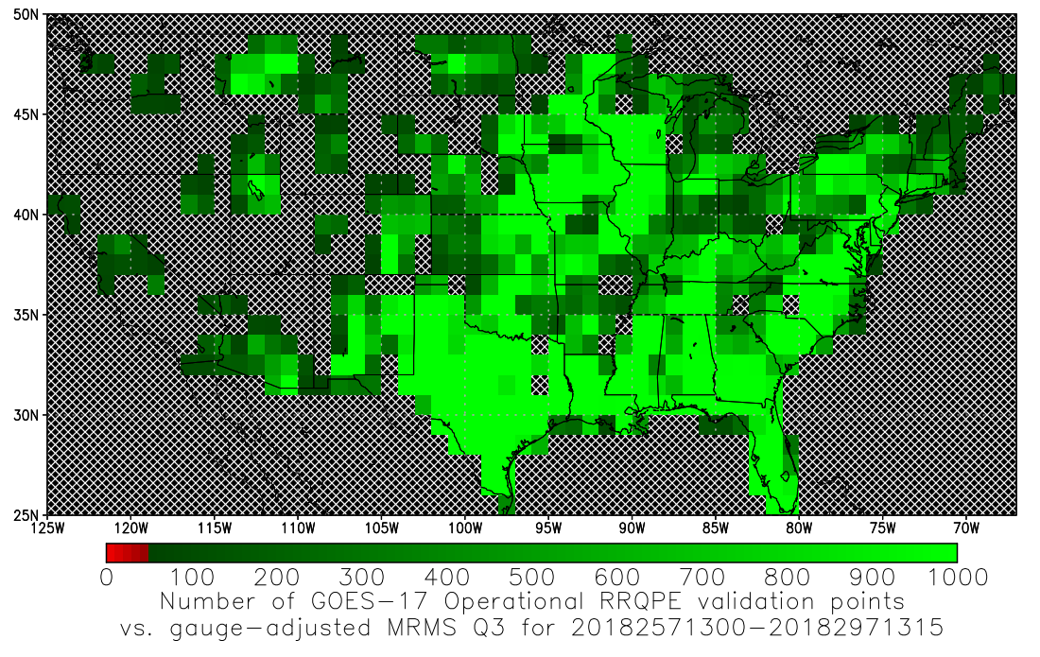
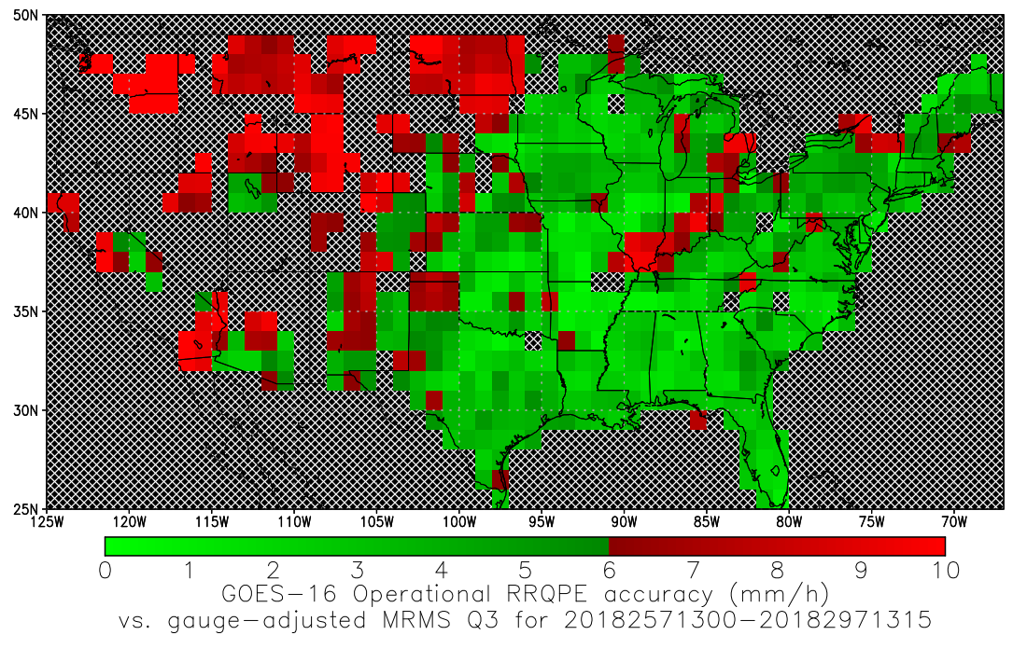
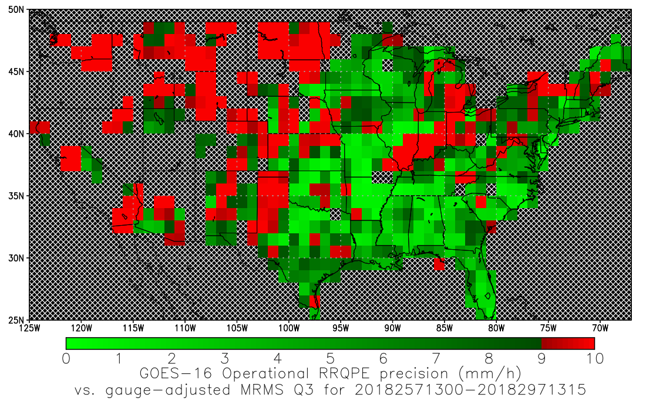
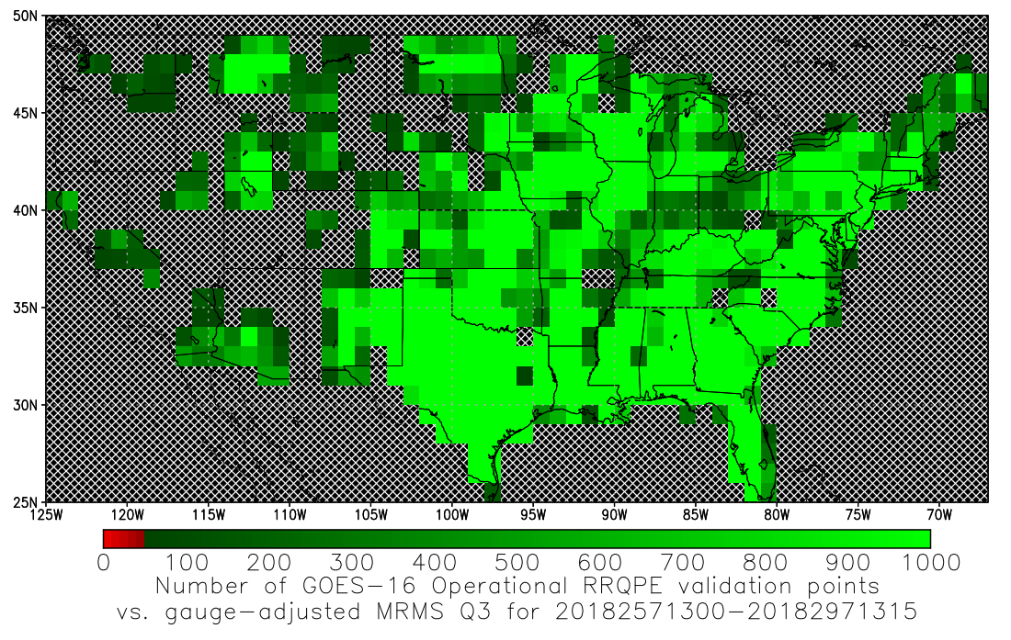
Validation Results: 89.5°W
Accuracy
Precision
Number of Data Points
Operational G17 Algorithm (not including 0500-2000 UTC)
Operational G16 Algorithm (not including 0500-2000 UTC)
Computed for pixels with retrieved rain rates of 9.5-10.5 mm/h for 13 September 2018 – 24 October 2019.

Slide 14
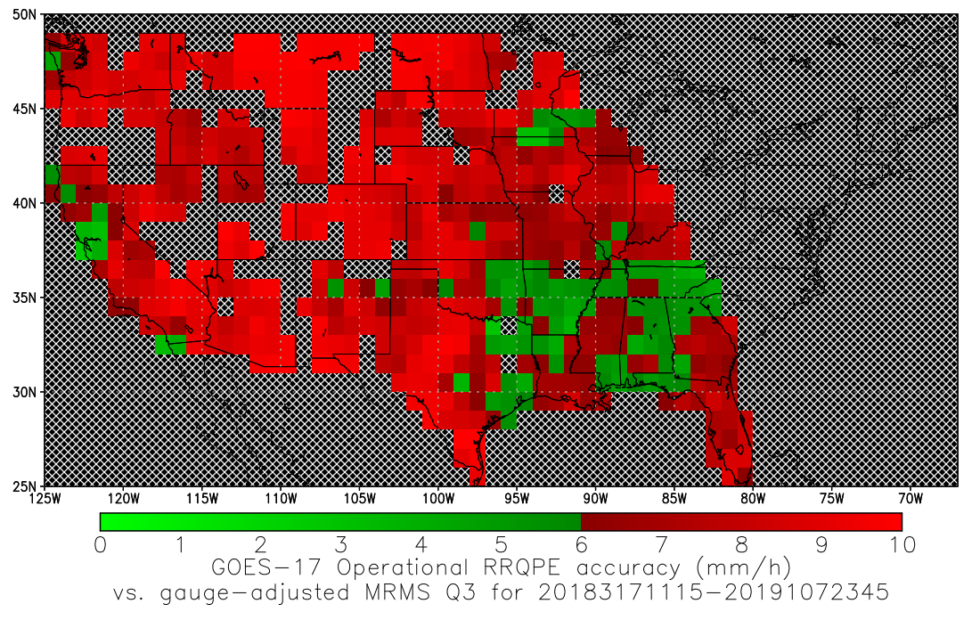
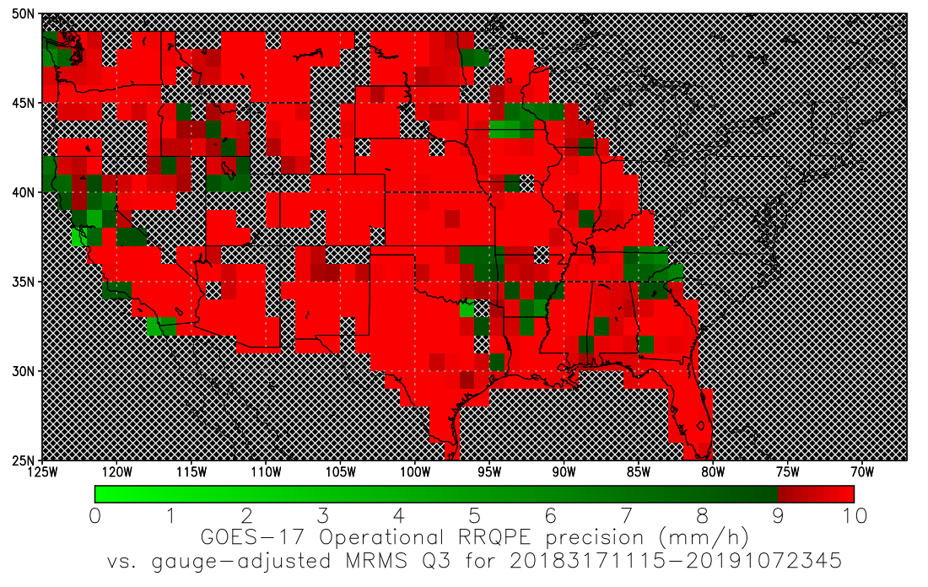
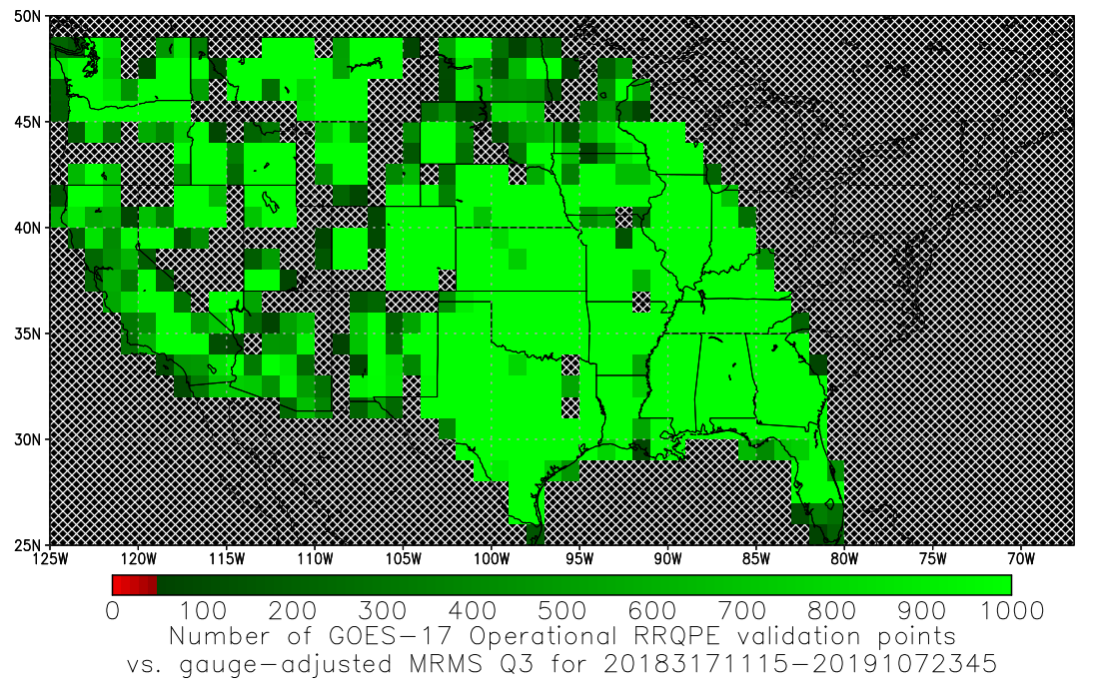
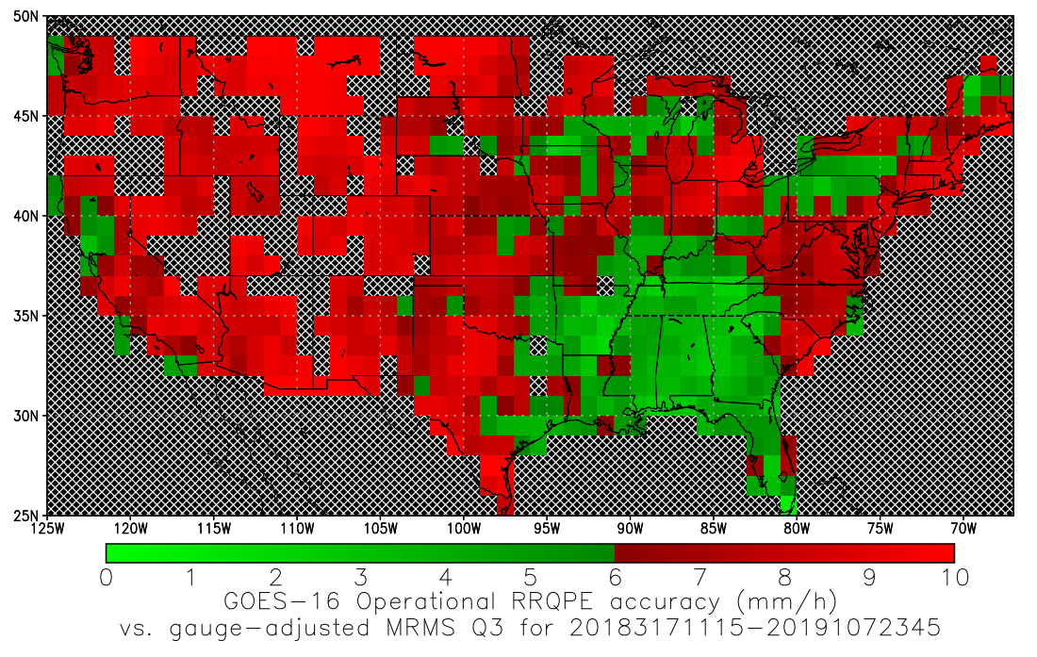
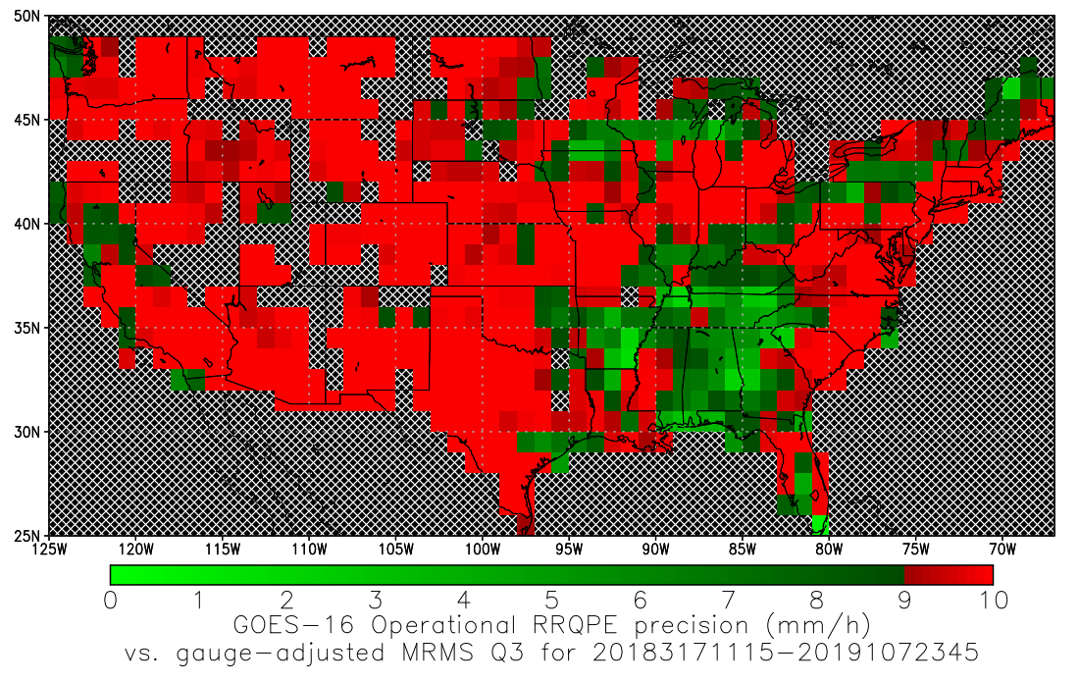
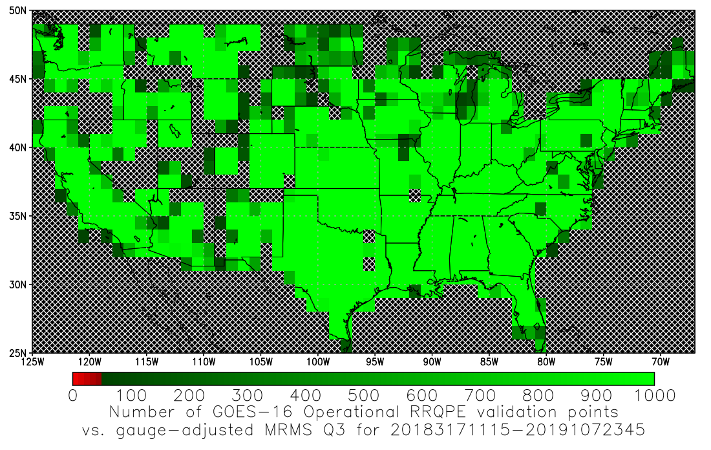
Validation Results: 137°W
Accuracy
Precision
Number of Data Points
Operational G17 Algorithm (not including 0500-2000 UTC)
Operational G16 Algorithm (not including 0500-2000 UTC)
Computed for pixels with retrieved rain rates of 9.5-10.5 mm/h for 13 November 2018 – 17 April 2019.

Slide 15
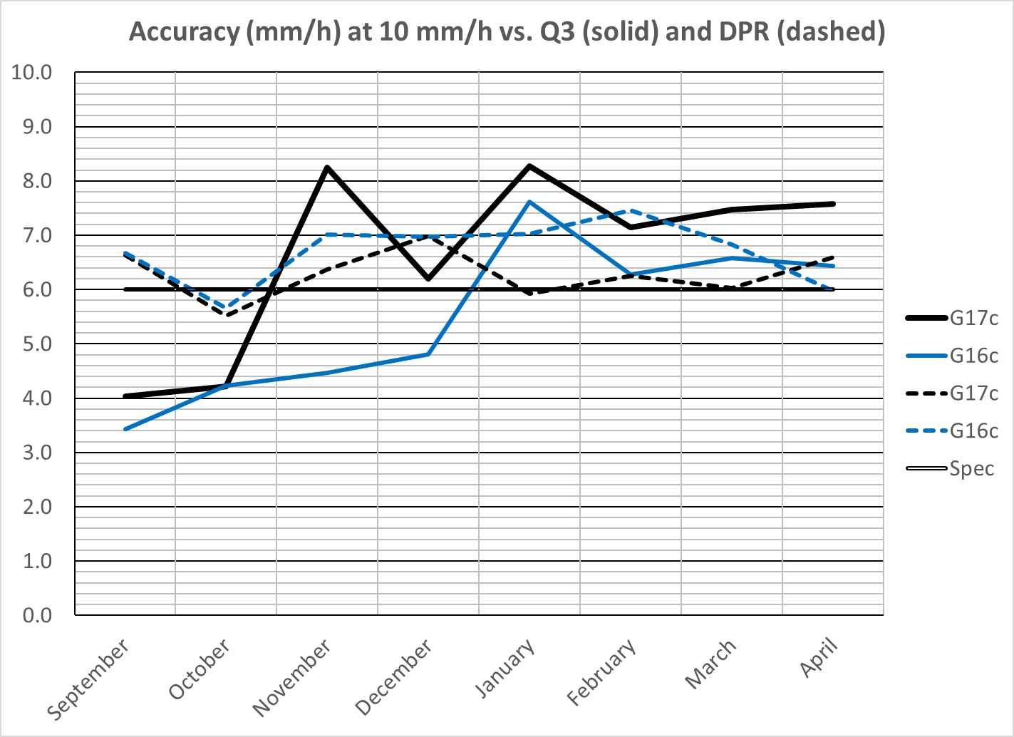
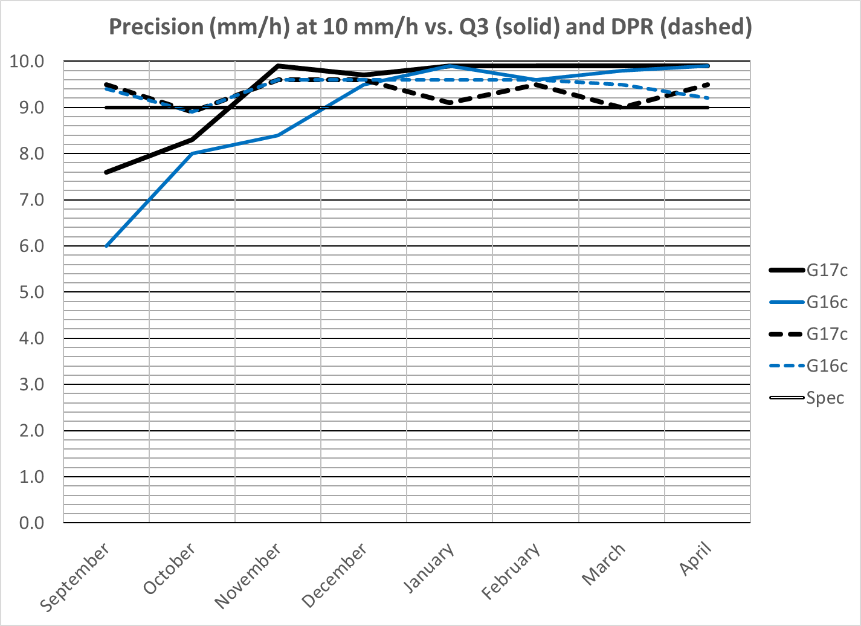
Monthly Validation Results
The G17 algorithm met spec vs. MRMS Q3 (CONUS) while at 89.5°W but fails to meet spec at 137°W.
The G17 algorithm performance is worse than G16 vs. Q3 (CONUS) but actually slightly better vs. DPR (FD), though not good enough to meet spec.
Again, expect better performance during warm season

Slide 16
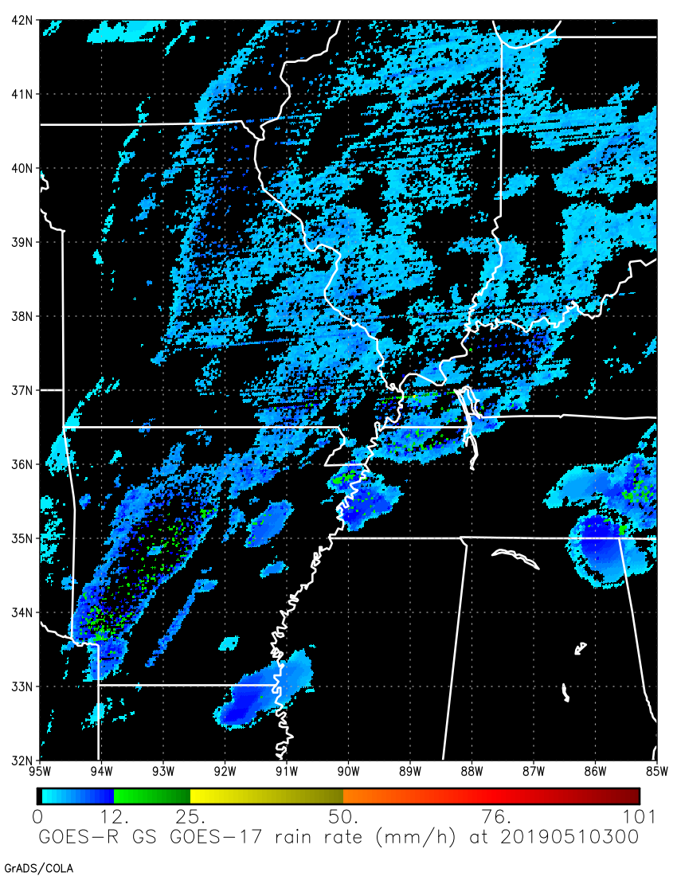
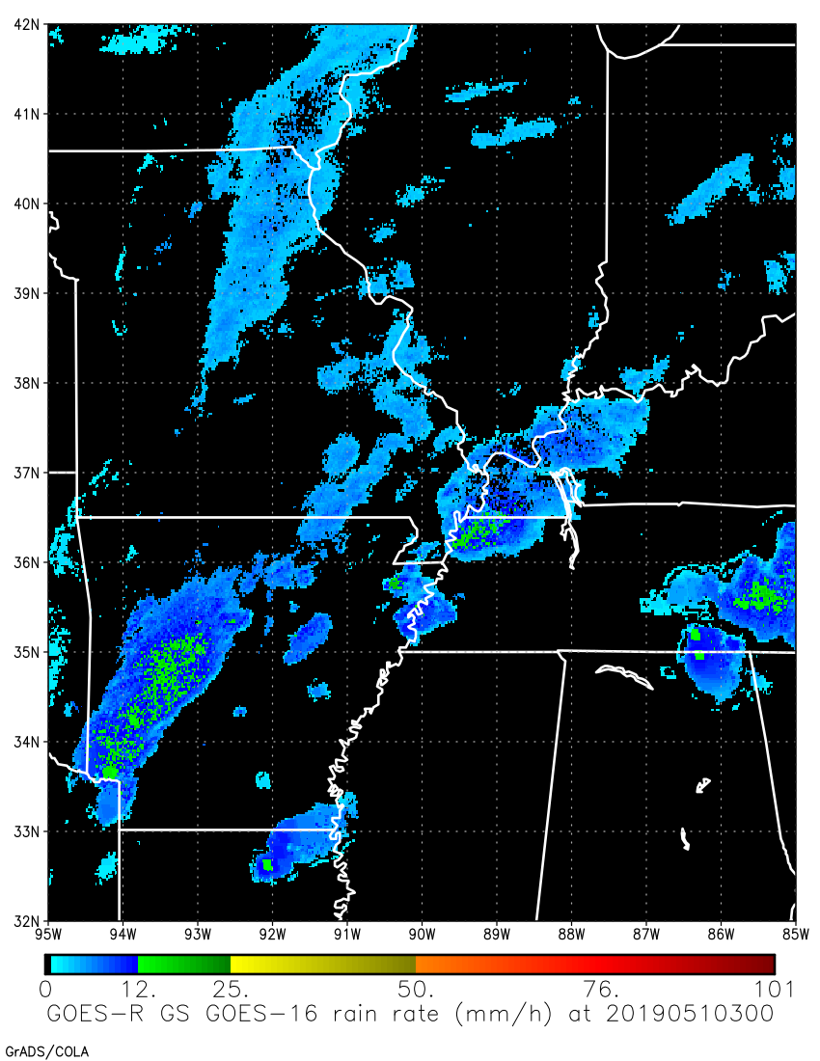
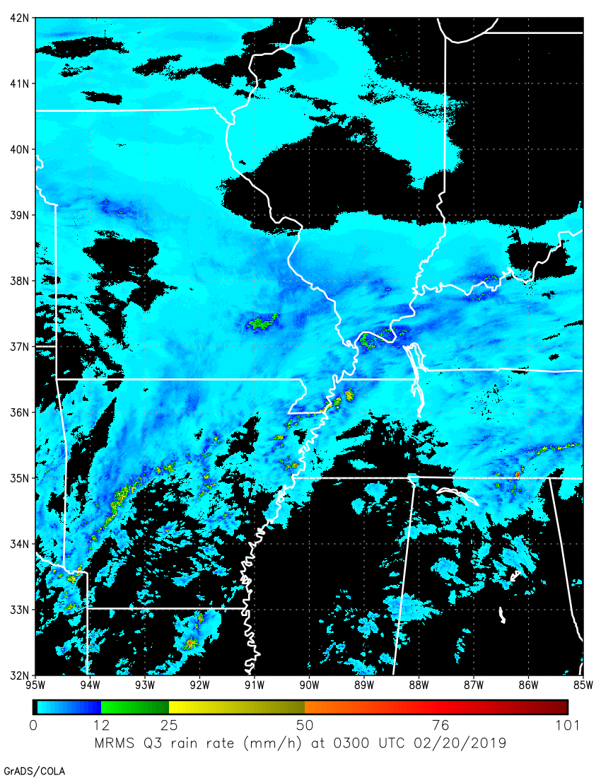
RRQPE Case Study 0300 UTC 20 Feb 2019
GOES-17
GOES-16
MRMS Q3

Slide 17
Missed GOES-17 Rainfall 0300 UTC 20 Feb 2019
GOES-17
GOES-16

Slide 18
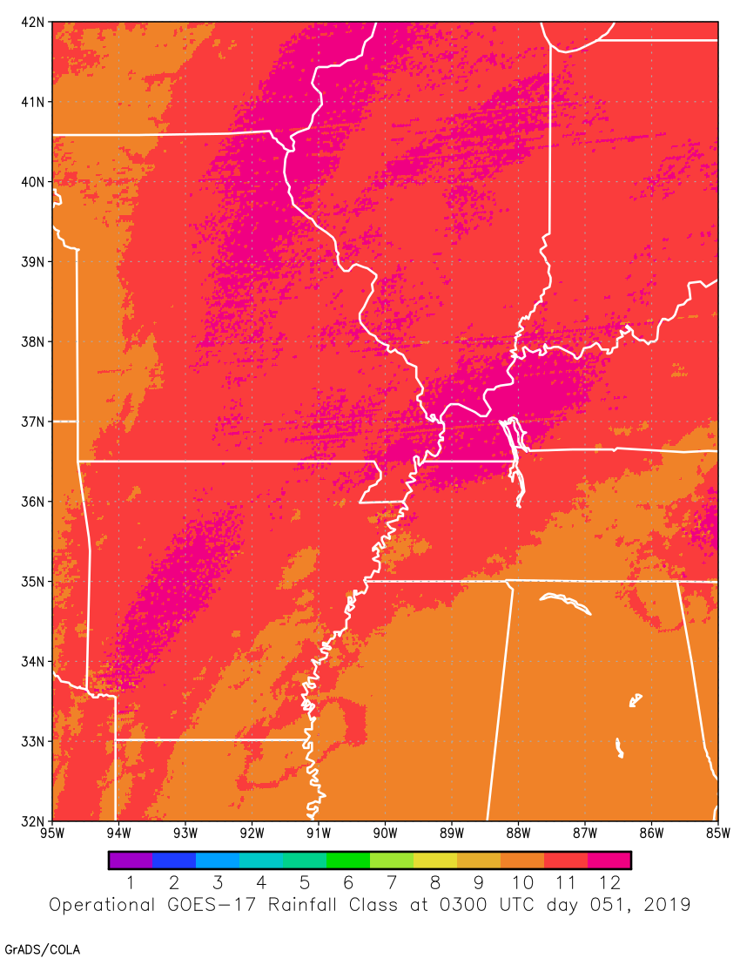
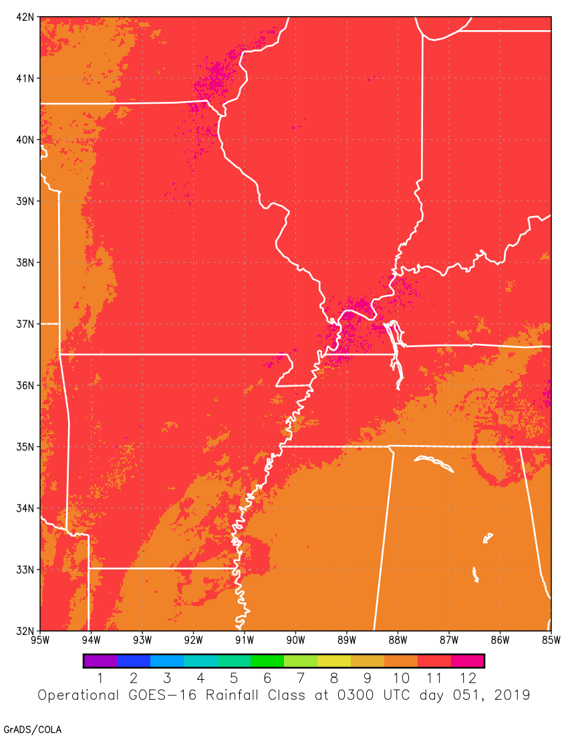
RRQPE Classes 0300 UTC 20 Feb 2019
GOES-17
GOES-16
“overshooting-top”
“overshooting-top”
“ice-top”
“ice-top”
“water-top”
“water-top”

Slide 19
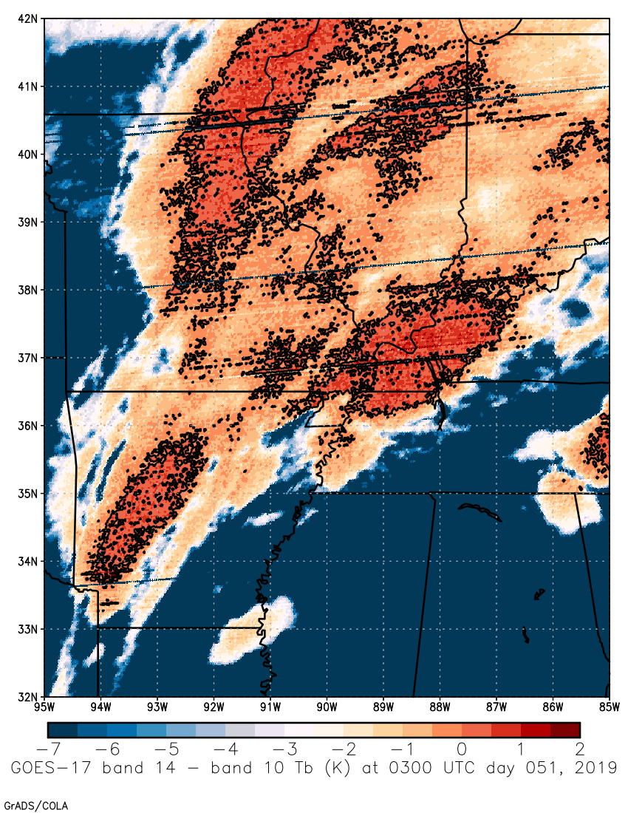
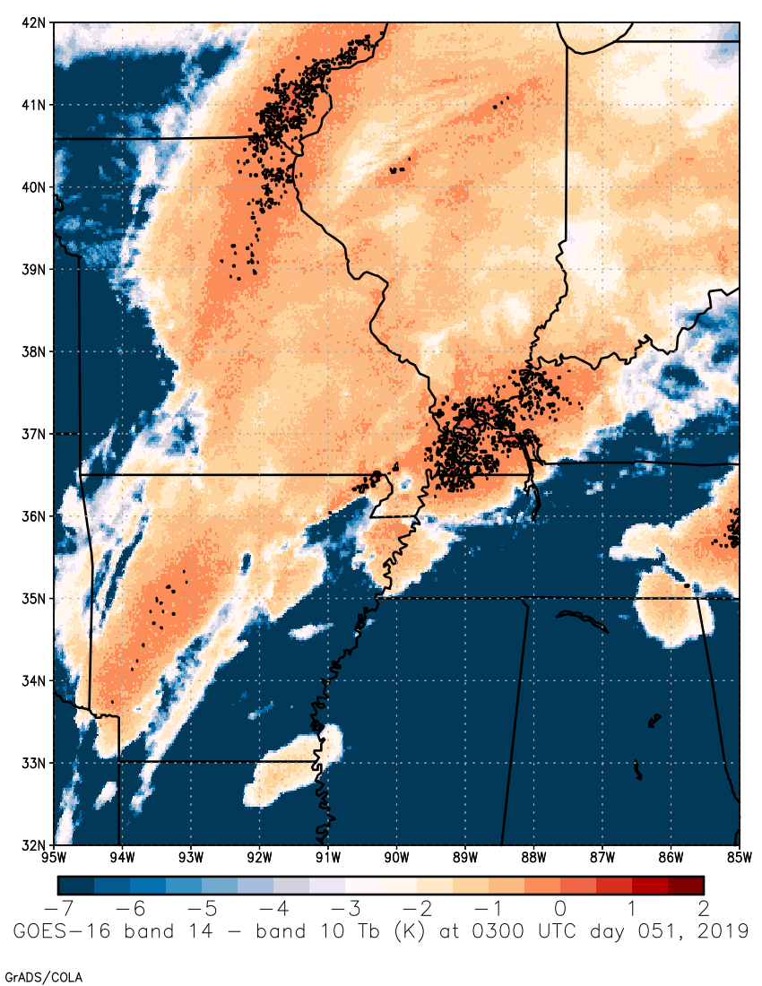
T_{11.2}-T_{6.19} 0300 UTC 20 Feb 2019
GOES-17
GOES-16
“overshooting-top” threshold = 0 K
“overshooting-top” threshold = 0 K

Slide 20
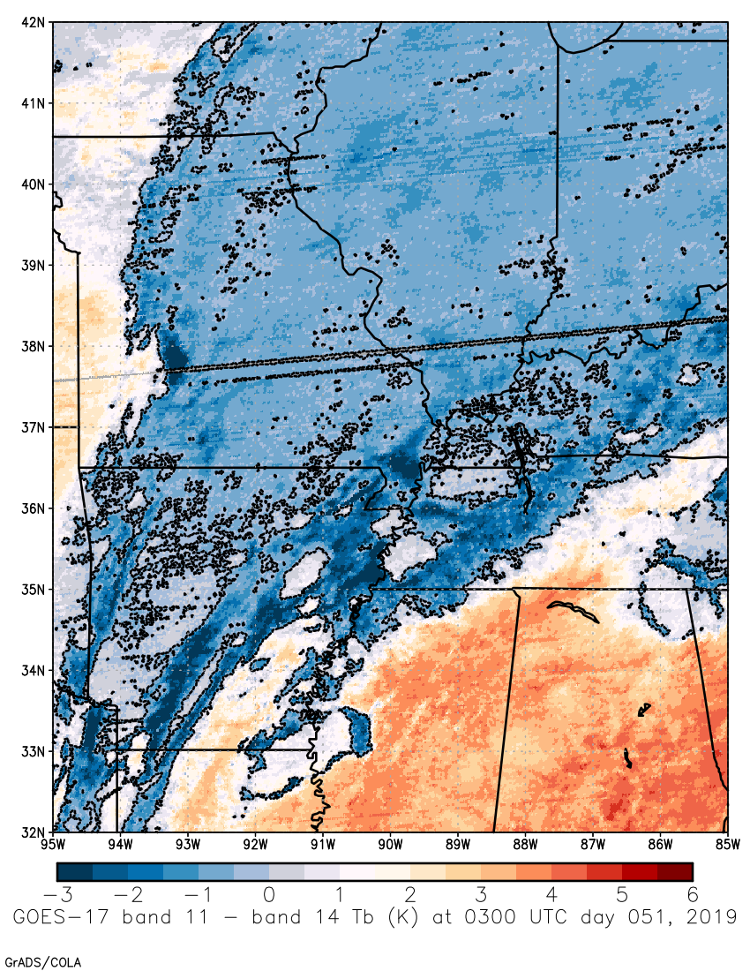
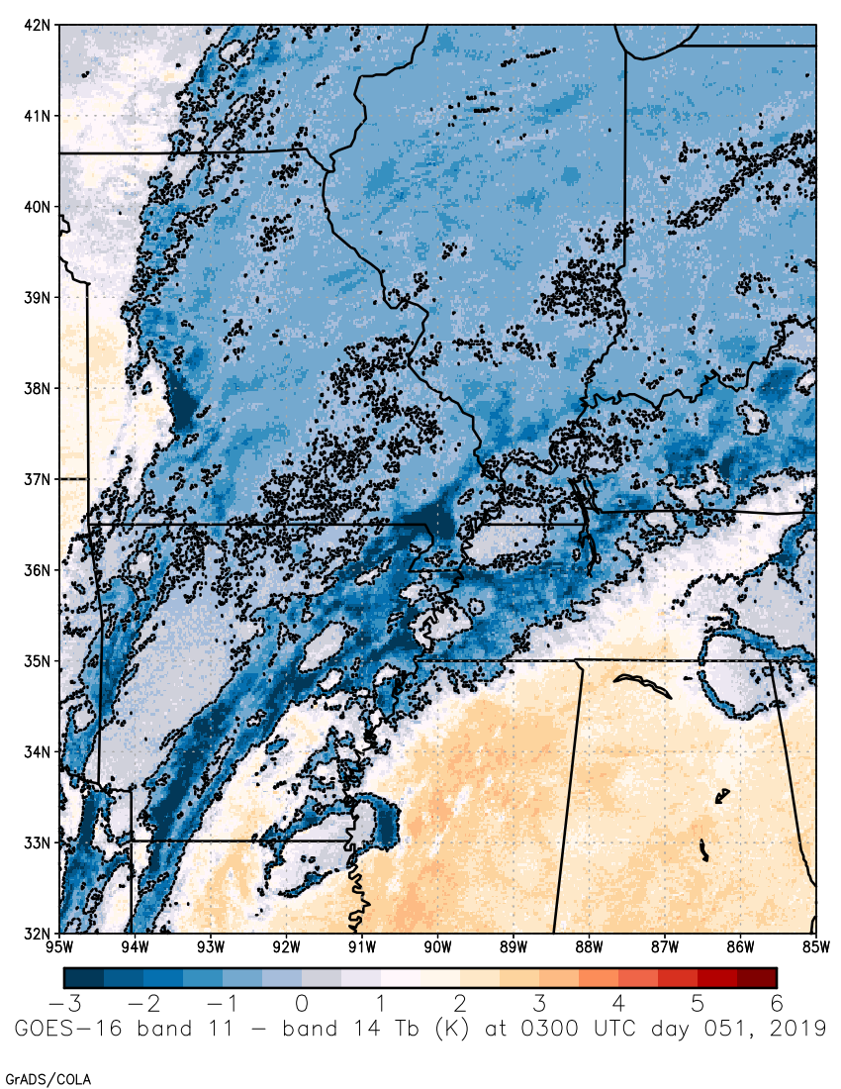
T_{8.5}-T_{11.2} 0300 UTC 20 Feb 2019
GOES-17
GOES-16
“ice-top” threshold = -0.3 K
“ice-top” threshold = -0.3 K

Slide 21
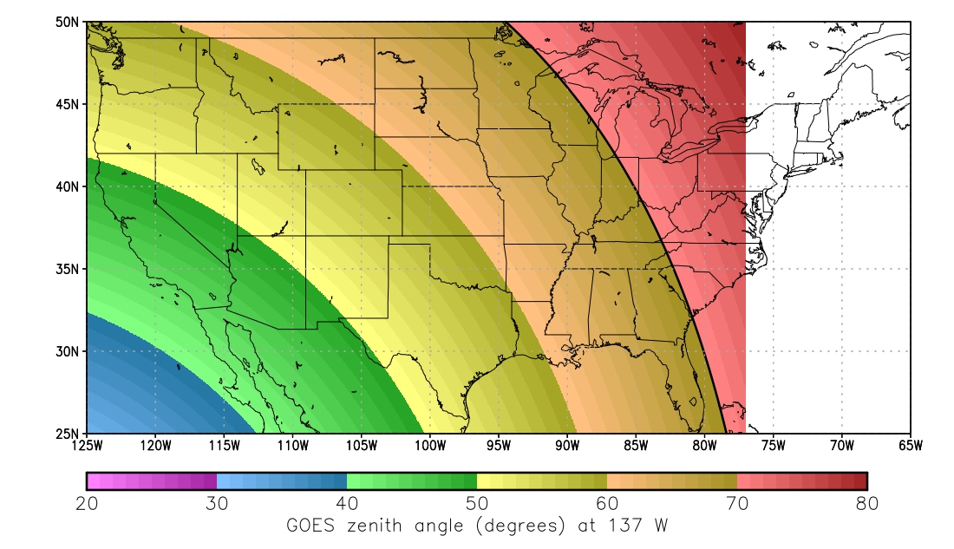
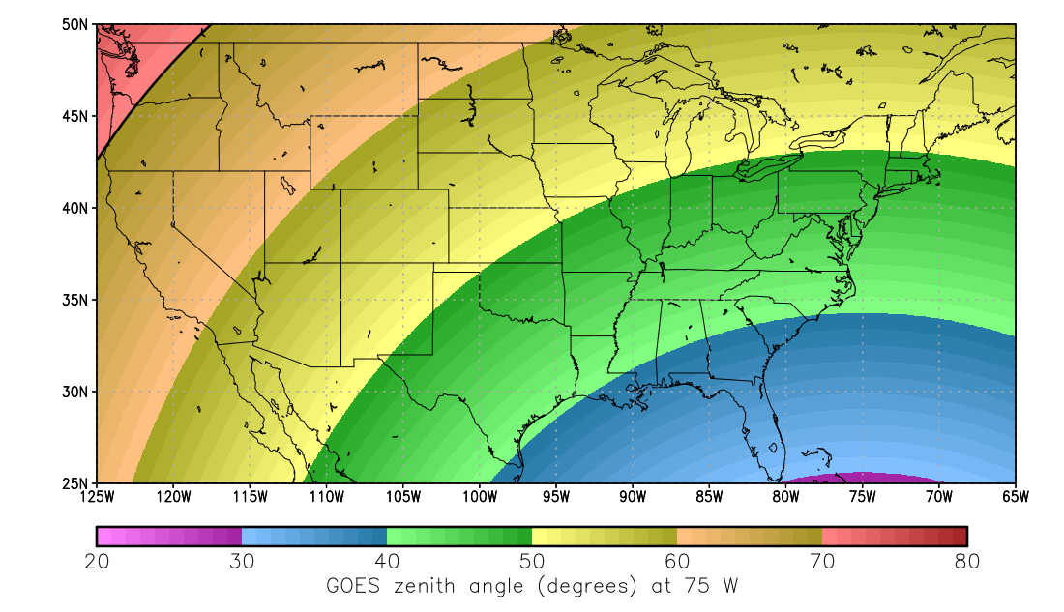
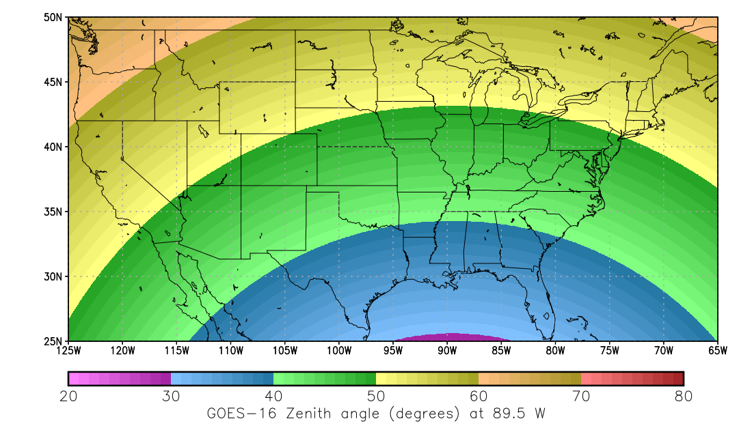
Differences in Viewing Angle
GOES-17 Operational (75°W)
GOES-16 Operational (75°W)
Checkout Position (89.5°W)

Slide 22
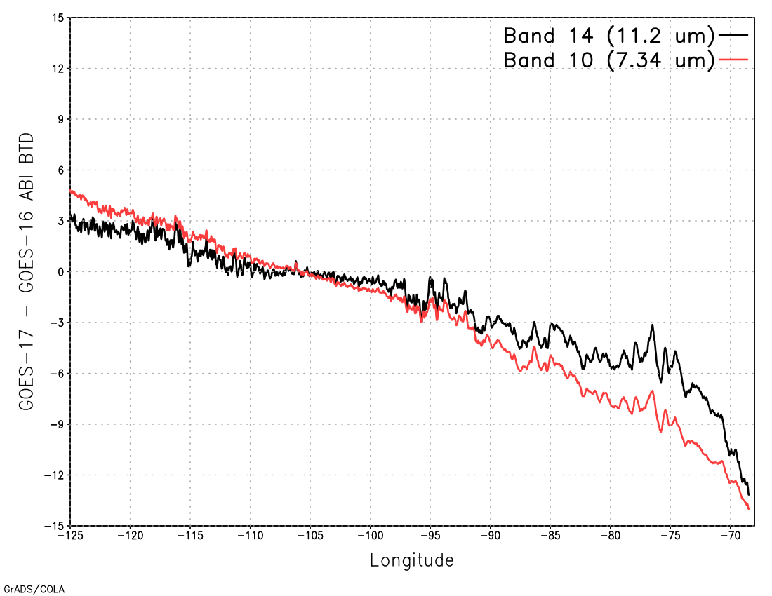
Limb Effects
Latitude-averaged (25-49°N) T_{b} differences between GOES-17 and GOES-16 vs. longitude at 0300 UTC 20 February 2019

Slide 23
Missed GOES-17 Rainfall 0300 UTC 20 Feb 2019
GOES-17
GOES-16

Slide 24
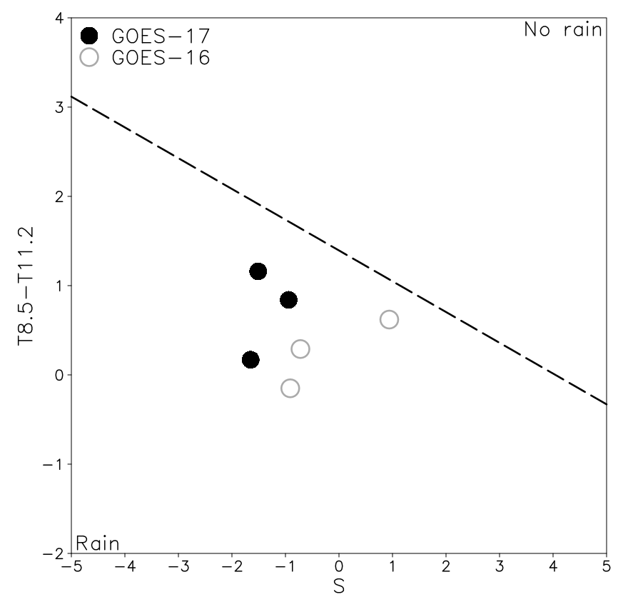
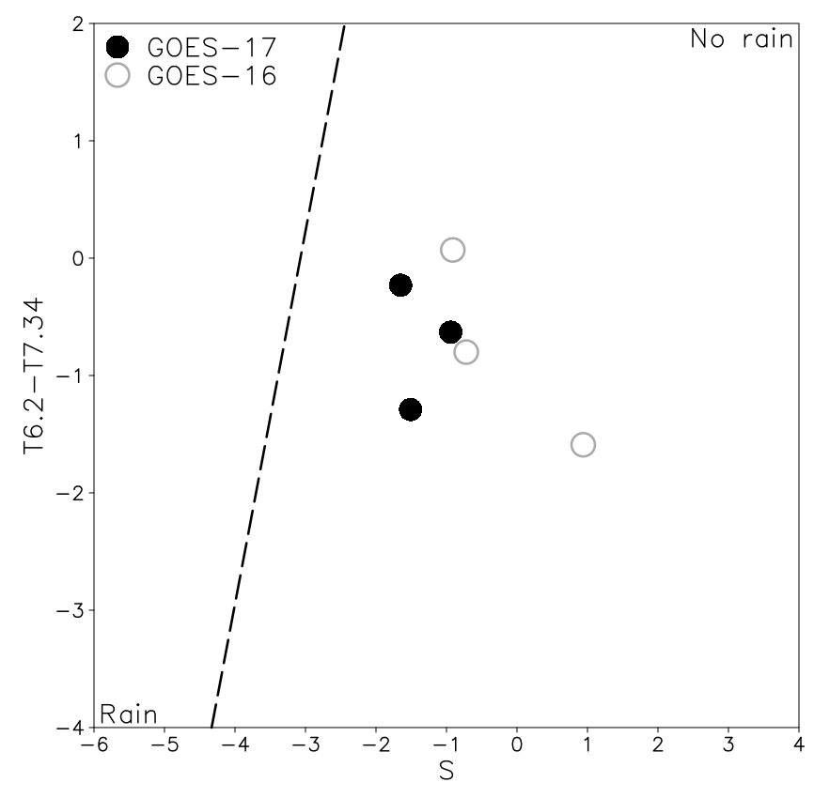
Rain / No Rain Separation for Sample Points
Class 11 (ice-top clouds; correct class)
Class 12 (overshooting-top clouds; incorrect class)

Slide 25
GOES-17 False Alarms 0300 UTC 20 Feb 2019
GOES-17
GOES-16

Slide 26
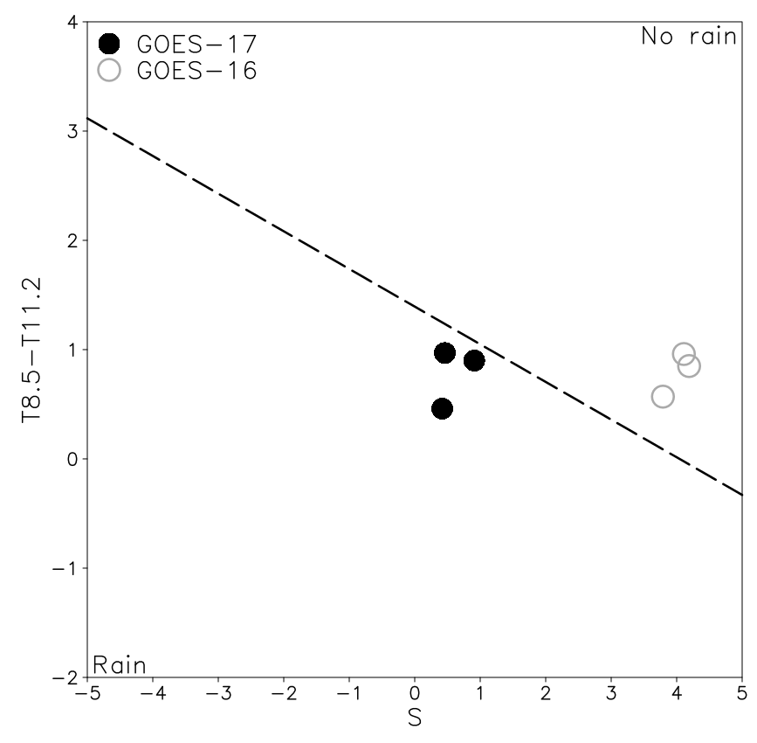
Rain / No Rain Separation for Sample Points
Class 11 (ice-top clouds)

Slide 27
Correction for Limb Effects?
Joyce et al. (2004) developed a climatologically-based limb correction for GOES IR window channels
No equivalent correction exists for the WV bands
Much more difficult to develop for WV bands because of much higher sensitivity to WV content—climatological value would not be good enough so would need RT path-length TPW
The result would be highly computationally expensive

Slide 28
Top Level Summary of Product Quality
The GOES-17 Rainfall Rate / QPE product performs at the same overall level as for GOES-16, but the greater limb darkening in the WV over the CONUS is degrading performance because of incorrectly classified rainfall.
Consequently, the GOES-17 Rainfall Rate / QPE product does not meet spec either over the CONUS or over the full-disk.
However, the operational-position evaluation was performed during the cool season when even GOES-16 does not meet spec over the CONUS; expect better performance during the warm season.

Slide 29
PROVISIONAL MATURITY ASSESSMENT
GOES-17 Rainfall Rate / QPE L2 Product Provisional PS-PVR

Slide 30
Provisional Validation
Preparation Activities | Assessment
Validation activities are ongoing and the general research community is now encouraged to participate. | Validation activities are ongoing.
Severe algorithm anomalies are identified and under analysis. Solutions to anomalies are in development and testing. | Cause of algorithm issue (limb cooling) has been identified.
Incremental product improvements may still be occurring. | Incremental product improvements may occur pending PS-PVR outcome; significant product improvement expected after transition to Enterprise code.

Slide 31
Provisional Validation
End State | Assessment
Product performance has been demonstrated through analysis of a small number of independent measurements obtained from select locations, periods, and associated ground truth or field campaign efforts. | This has been demonstrated.
Product analysis is sufficient to communicate product performance to users relative to expectations (Performance Baseline). | This has been communicated in PS-PVR.
Documentation of product performance exists that includes recommended remediation strategies for all anomalies and weaknesses. Any algorithm changes associated with severe anomalies have been documented, implemented, tested, and shared with the user community. | These are documented in this slide deck and will be documented in a separate ReadMe file.
Testing has been fully documented. | Testing will be documented in a PLPT Report.
Product is ready for operational use and for use in comprehensive cal/val activities and product optimization. | We concur.

Slide 32
Recommendation
AWG Hydrology Team recognizes that the GOES-17 Rainfall Rate / QPE product does not meet spec, but a mitigating factor is only being able to evaluate the product from operational position during the cool season.
AWG Hydrology Team still recommends declaring that it has reached Provisional Maturity as defined by the GOES-R Program
Users in the CONUS areas affected by GOES-17 limb cooling would presumably use GOES-16

Slide 33
Recommendation: Limb Mitigation
Modifying the calibration coefficients to account for limb effects over the CONUS would degrade performance elsewhere (e.g., Hawaii)
Developing a rigorous limb correction for the WV bands would require additional resources and significant operational computation time
Varying the BTD thresholds for cloud classification with satellite zenith angle will be explored for the Enterprise code
The Enterprise algorithm partially addresses this with 15x15-deg lat/lon calibration regions—limb effects are partially accounted for in calibration
Recommendation: wait until Enterprise algorithm deployment

Slide 34
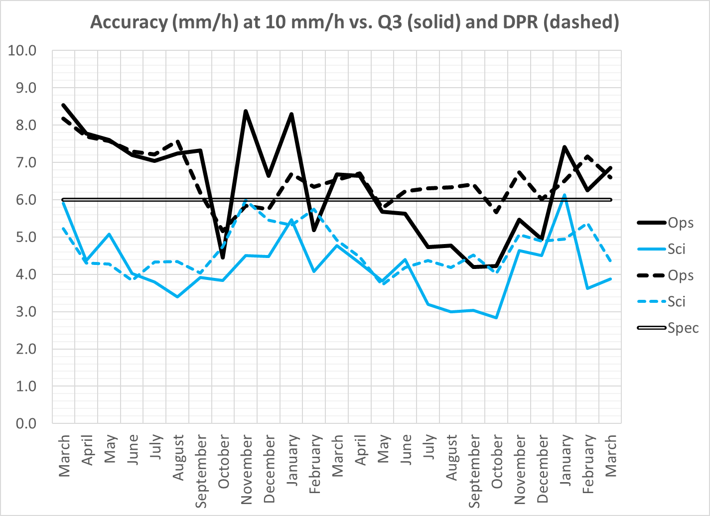
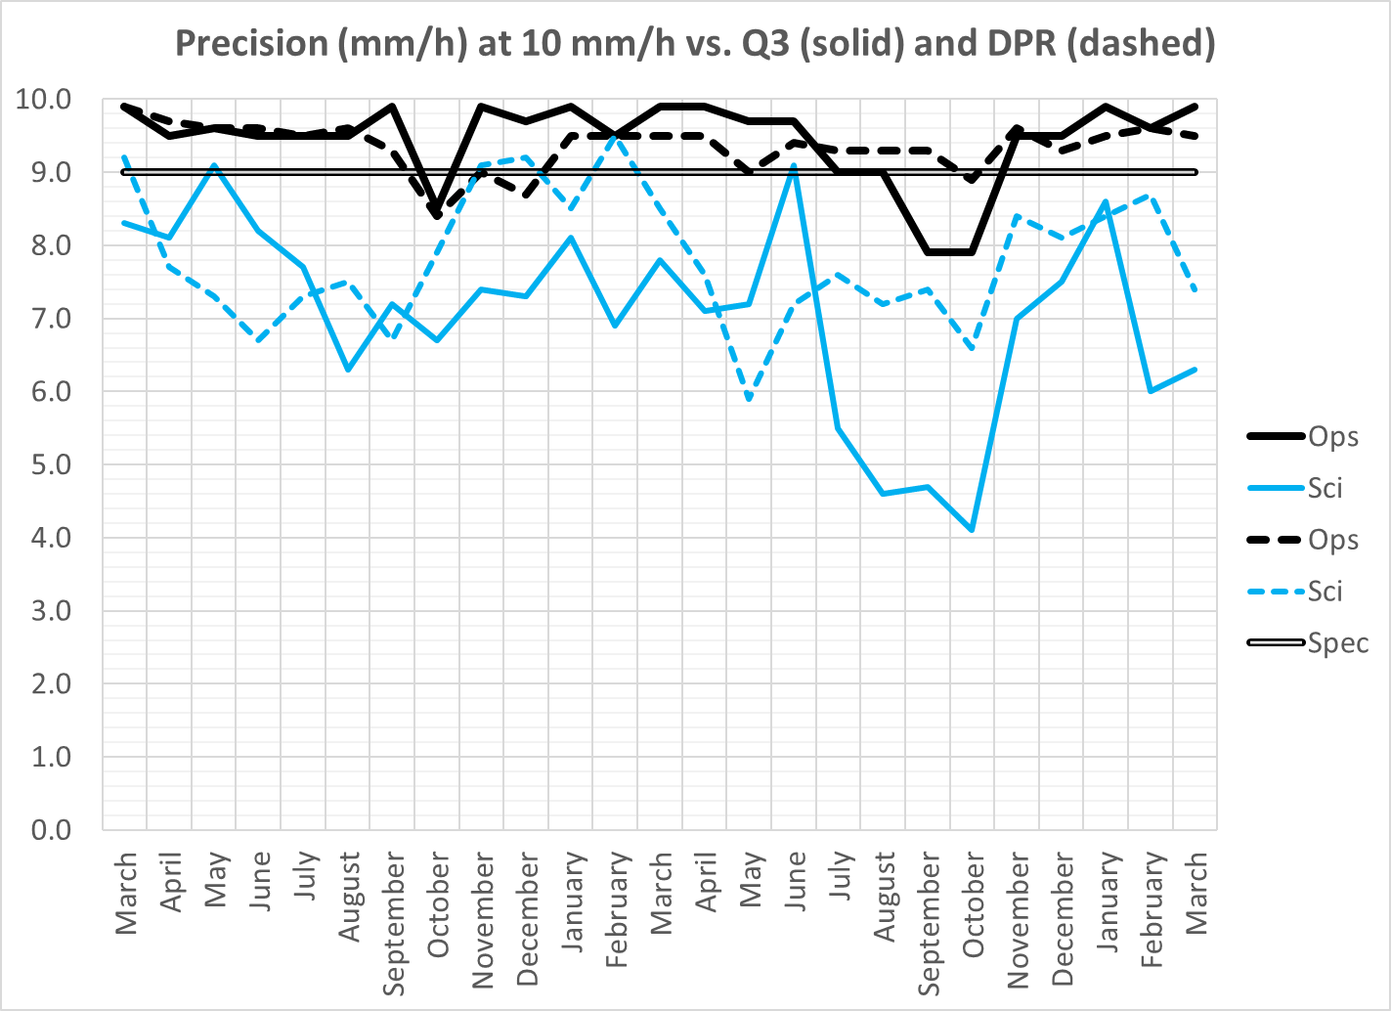
Enterprise Algorithm Performance (GOES-16)
Have not run the Enterprise code on GOES-17 yet; still making changes for LHP mitigation.
Enterprise code meets spec on GOES-16 by a comfortable margin; should do for GOES-17 even if there is some limb-induced degradation.

Slide 35
Path to DELTA Validation Maturity
GOES-17 Rainfall Rate / QPE L2 Product Provisional PS-PVR

Slide 36
Issues and Status ADRs Needing Resolution for Full VAL
No outstanding ADRs at this time.

Slide 37
Path to Delta Validation - PLPTs
PLPT ID | Descriptive Title
ABI-FD_QPE04 | Assess accuracy and precision of Rainfall Rate / QPE product vs. reference / ground truth data (using 24-h data instead of only data from “cool”-FPM periods)
AWG Hydrology Team is modifying the Enterprise code to use only band 14 (since it is the most robust) whenever the FPM temperature exceeds a threshold value.
AWG Hydrology Team will work with ASSISTT and PRO to integrate the Enterprise code into operations.
AWG Hydrology Team will evaluate the L2 Rainfall Rate / QPE product quality on the Enterprise products for all time periods.
Full test plans and procedures are given in the Rainfall Rate / QPE Readiness, Implementation, and Management Plan (RIMP)

Slide 38
Path to Delta Validation – Risks
Risk Name | Description | Impact | Mitigation and Schedule
Enterprise Code Transition | IF the transition to Enterprise code is delayed | THEN the Delta validation would have to be delayed to collect sufficient data for analysis | Current schedule for AWG to deliver code to ASSISTT 11/1/19; ASSISST→PRO 12/24/19; PRO→OE 3/27/20 Delta PS-PVR currently scheduled for 6/11/20
Little Impact
Moderate Impact
Big Impact

Slide 39
Summary & Recommendations
GOES-17 Rainfall Rate / QPE Product Provisional PS-PVR

Slide 40
Summary
The GOES-17 Rainfall Rate / QPE product performs at roughly the same level as the GOES-16 product over the full disk
However, limb cooling affects the rainfall type classification, which results in the wrong rain / no rain and rain rate equations being applied to pixels farther out on the limb
This in turn can produce false alarms or missed rainfall
Mitigation in the Enterprise code via SZA-dependent BTD thresholds will be explored
Mitigation in the GS is possible; however, it would divert resources away from the Enterprise algorithm transition and precede the Enterprise algorithm in operations by only a few months.

Slide 41
Recommendation
AWG Hydrology Team recognizes that the GOES-17 Rainfall Rate / QPE product does not meet spec, but a mitigating factor is only being able to evaluate the product from the operational position during the cool season.
AWG Hydrology Team still recommends declaring that it has reached Provisional Maturity as defined by the GOES-R Program
Users in the CONUS affected by GOES-17 limb cooling would presumably use GOES-16

Slide 42
Questions?

